Slide 1



SYNAPMEET
Smart Meeting Summarizer
Team Members:(CSE2526MNP-F12)
22R11A05P7-B.Tanishq Anand
22R11A05P8-B.Sasha
22R11A05Q6-K.Vinay

Slide 2
ABSTRACT
SynapMeet is a smart meeting assistant designed to automate post-meeting workflows by transforming spoken discussions into concise summaries, action items, and key decisions. Using speech recognition and intelligent algorithms, it enhances productivity, eliminates manual note-taking, and ensures effective follow-ups. The platform offers real-time synchronization, a user-friendly dashboard, and seamless integration for modern team collaboration.

Slide 3
INTRODUCTION
Background:
Meetings often end without clear documentation of decisions and responsibilities. This results in unorganized outcomes, forgotten tasks, and a lack of team accountability.
Motivation:
Manual note-taking disrupts active participation and is prone to missing key points. It is also inefficient and inconsistent across different meetings.
Objective:
To build a system that records and transcribes meetings automatically . It extracts summaries, action items, and decisions to ensure effective follow-up and clarity.

Slide 4


In many organizations, valuable meeting insights are lost due to ineffective note-taking and lack of structured follow-up. Manual summarization is time-consuming, error-prone, and often skipped. There is a need for an automated solution to transcribe and summarize meetings to enhance productivity and accountability.
PROBLEM STATEMENT

Slide 5

EXISTING SYSTEM
Manual Note-Taking Tools
Notion and Google Docs rely on users to manually take notes, which is time-consuming and prone to errors.
Transcription-Only Tools
Otter.ai and Zoom Transcripts convert speech to text but lack summary generation, action item extraction, and follow-up features.
LIMITATIONS
No automatic extraction of summaries, action items, or decisions
Lack of contextual understanding or content prioritization
Absence of a smart dashboard for organizing and visualizing meeting outcomes

Slide 6

PROPOSED SOLUTION
SynapMeet provides an end-to-end solution that:
Records & Transcribes Meetings
Captures audio and converts speech to text using advanced speech recognition.
Extracts Key Insights
Uses NLP to generate summaries, identify decisions, and extract action items.
Structured Dashboard
Presents meeting content in an organized, searchable, and user-friendly interface.
Real-Time Sync
Ensures updates are instantly reflected across all connected users and devices.

Slide 7
KEY FEATURES OF SYNAPMEET
Speech-to-Text Conversion
Converts meeting audio into accurate and readable text using Whisper.
Automated Summary & Action Item Extraction
Identifies key points, decisions, and tasks using NLP techniques.
Meeting Minutes Generation
Automatically prepares concise and structured meeting minutes.
Real-time Dashboard with Sync
Updates meeting data instantly for all users with real-time synchronization.
Seamless Integration Possibilities
Can be extended to integrate with tools like calendars, task managers, and storage platforms.

Slide 8
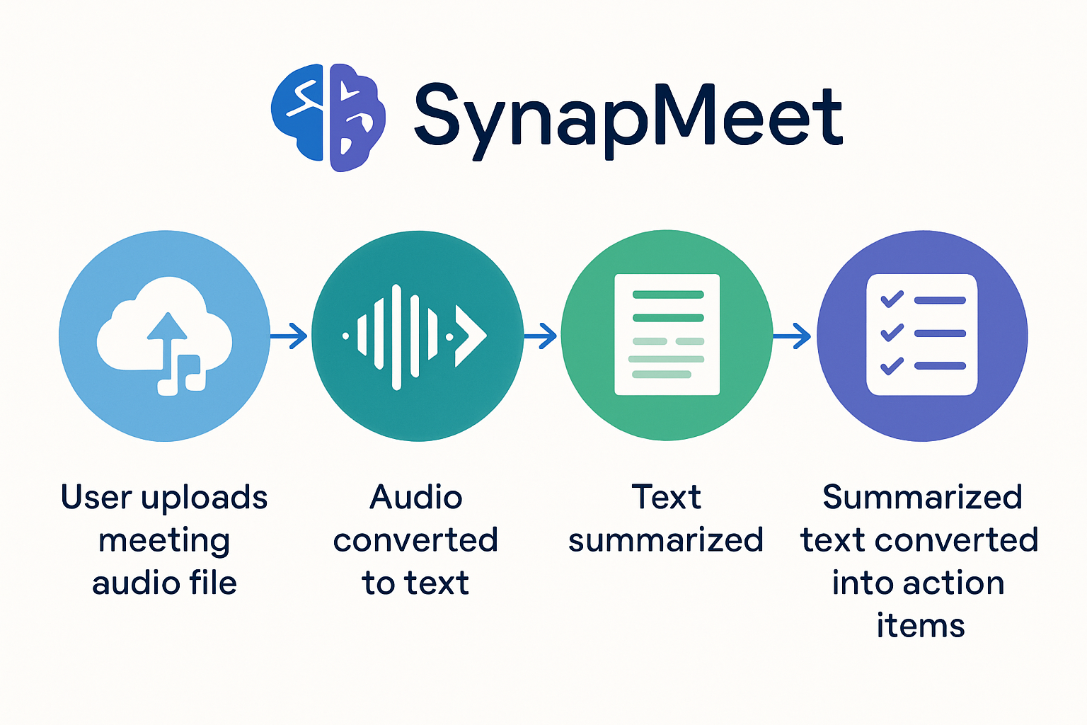
ARCHITECTURE DIAGRAM

Slide 9
TECHNOLOGY STACK
FRONTEND
BACKEND
Python
(Flask)
HTML & CSS
SPEECH RECOGNITION
NLP & PROCESSING
DEPLOYMENT
OpenAI Whisper
SpaCy / NLTK /Transformers
Localhost / Cloud (future)

Slide 10
MODULES OVERVIEW
Audio Input
Users can either upload pre-recorded audio files or record live meetings directly through the platform, ensuring flexible input options.
Speech-to-Text
Utilizes OpenAI’s Whisper model to transcribe spoken language into accurate, readable text, even in the presence of noise or accents.
Summary Generation
Applies Natural Language Processing (NLP) techniques to extract the core points and generate concise, context-aware summaries of the discussion.
Action Item Extraction
Detects actionable tasks, assigned responsibilities, and key decisions made during the meeting, ensuring no important point is missed.
Dashboard
A clean, user-friendly dashboard presents summaries, action items, and transcripts in an organized, searchable, and interactive format.

Slide 11
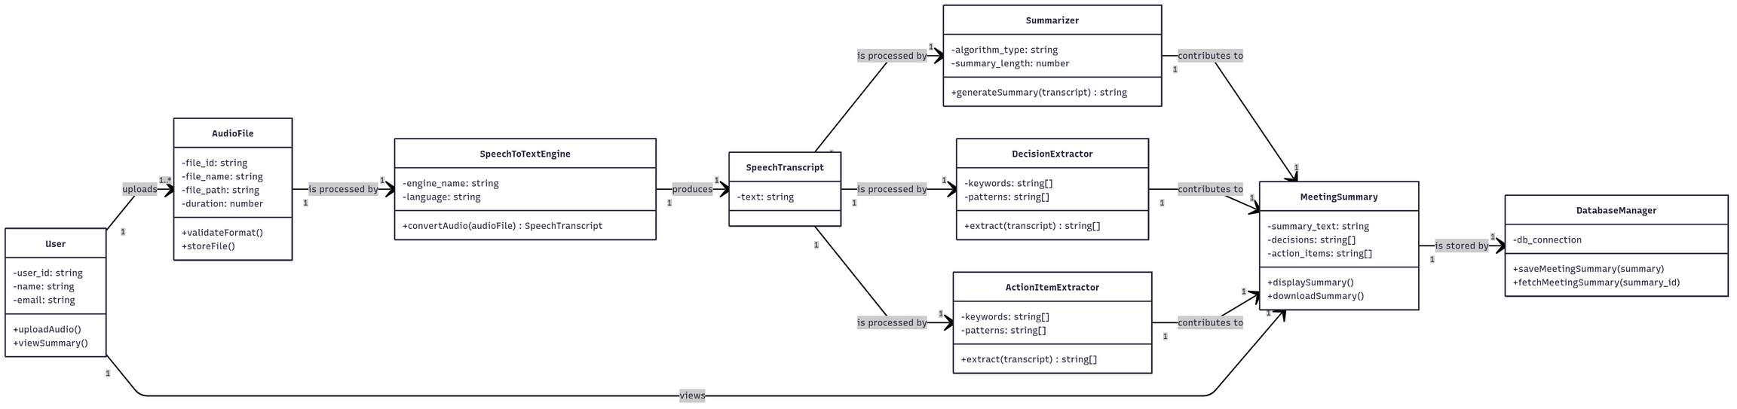
CLASS DIAGRAM

Slide 12
ALGORITHM
Step 1: Start
User opens the SynapMeet web application.
Step 2: Upload Meeting Audio
The system provides a button to upload an audio file of the meeting.
The uploaded file is validated (format, size).
Step 3: Convert Audio to Text
The system uses a Speech-to-Text engine (e.g., SpeechRecognition ) to transcribe the audio into raw text(Open AI Whisper).
Store the transcription internally .
Step 4: Summarization of Transcript
The transcription text is processed by the Text Summarization Module.
Summarization is deterministic (rule-based or algorithmic), focusing on condensing the content.

Slide 13
Step 5: Extract Key Outputs
Transcript Summary: Generate a readable summary of the meeting.
Key Decisions: Detect decision-making phrases (e.g., “we decided to…”, “the plan is…”).
Action Items: Identify actionable tasks (e.g., “X will complete Y by date”).
Step 6: Display Results
Show the summarized transcript on the dashboard.
Display extracted action items and key decisions separately in structured format.
Step 7: End
Optionally, store meeting results in a database for future access.
User can view the results.

Slide 14


CHALLENGES & SOLUTIONS
Noisy or unclear audio
Solved by using the Whisper model, which has strong noise handling capabilities.
Extracting meaningful actions
Addressed through custom rule-based logic combined with NLP pipelines for better accuracy.
Summarizing long transcripts
Managed using chunking and Transformer-based summarization models to retain context.
Real-time synchronization
Achieved through an efficient backend and polling mechanisms for instant updates.
UI responsiveness
Ensured by using a lightweight, modular frontend design for a smooth user experience.

Slide 15
LITERATURE SURVEY
Amazon Nova: Meeting Summarization & Action-Item Extraction
Amazon blog post (June 2025)
Shows how LLM prompt engineering via Amazon Nova models can produce summaries and action item lists in a structured format.
Includes evaluation using QMSum dataset and performance metrics.
Good for demonstrating industry-standard LLM pipelines for meeting insights.
Action-Item-Driven Summarization of Long Meeting Transcripts
By Logan Golia & Jugal Kalita (Dec 2023, arXiv)
This paper introduces a novel pipeline:
Performs topic-based segmentation, then uses recursive abstractive summarization to incorporate action items into the summary.
Achieves ~5% improvement in BERTScore on the AMI corpus.
Highly relevant to your goals of enhancing meeting summaries by explicitly focusing on action items.

Slide 16
Summaries, Highlights, and Action Items: Design…
By Sumit Asthana et al. (Jul 2023, arXiv)
Develops two recap representations: “Highlights” (concise key takeaways) and a hierarchical minutes view.
Applies an LLM-based dialogue summarization system and evaluates with real users.
Critical for justifying recap UX design decisions and feasibility with LLMs.
Meeting Action Item Detection with Regularized Context Modeling
By Jiaqing Liu et al. (Mar 2023, arXiv)
Tackles action item detection using local/global context through contrastive learning.
Introduces a new annotated corpus in Chinese and experiments on the English AMI dataset.
A useful framing if you plan to build or compare supervised extraction methods

Slide 17
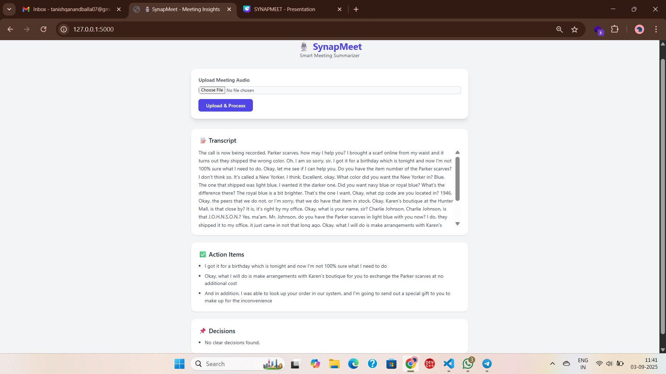
OUTPUT SCREENS

Slide 18
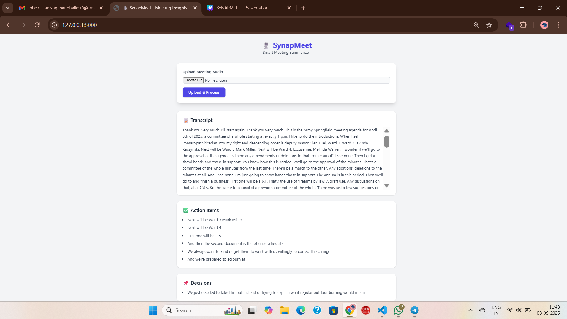

Slide 19
FUTURE WORK
Multi-Language Support
Enable transcription and summarization in regional and international languages for broader accessibility.
Calendar Sync
Sync meeting summaries with calendar events for contextual scheduling and reminders.
Enhanced Frontend Development
Improve the user interface with advanced design frameworks (like React or Vue) for a more responsive and interactive experience.
Cloud Deployment
Host the application on cloud platforms (e.g., AWS, GCP) for scalable access and storage.

Slide 20
SynapMeet addresses a real productivity gap by automating the extraction of critical meeting content.
It enhances collaboration by turning unstructured discussions into actionable items.
With intelligent transcription, summarization, and a user-centric dashboard, SynapMeet is poised to transform how meetings are followed up and executed.
CONCLUSION

Slide 21
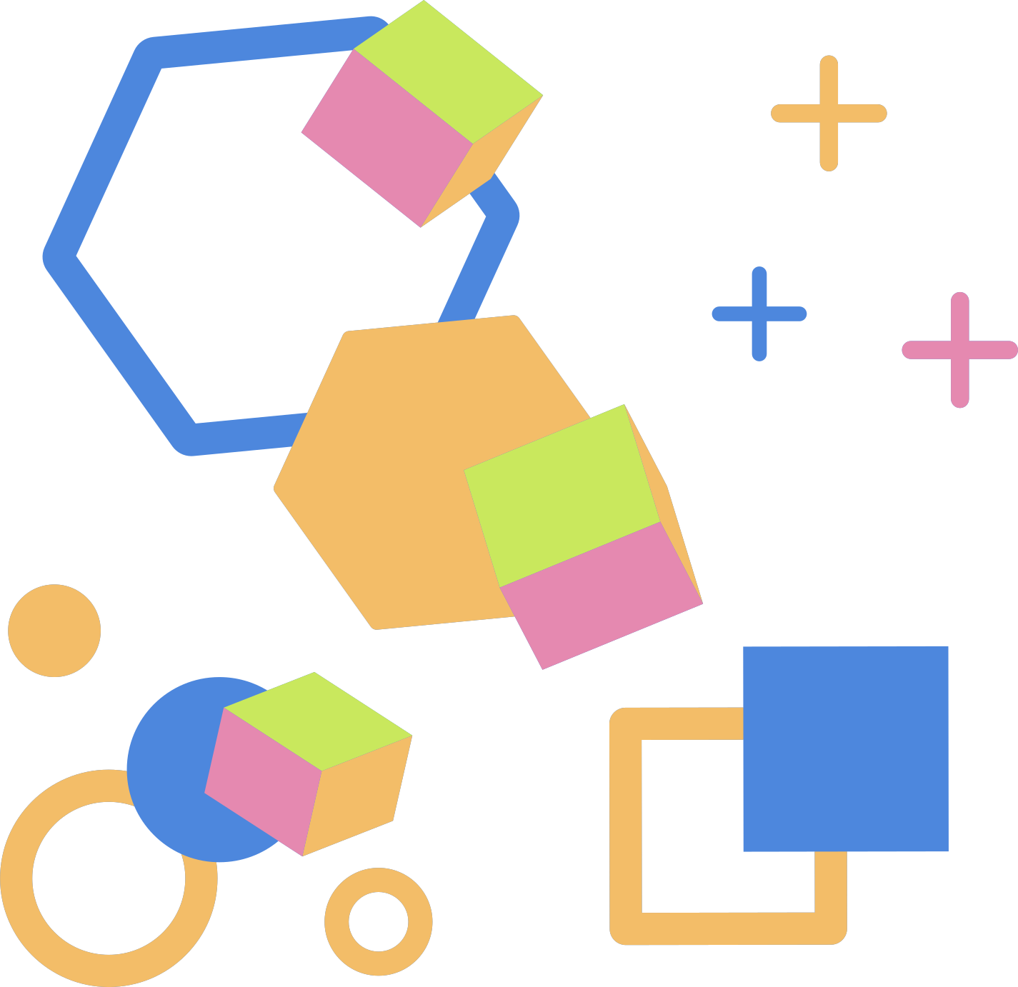



THANK YOU

